Slide 1
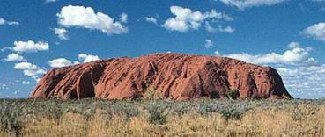
Aboriginal Art

Slide 2
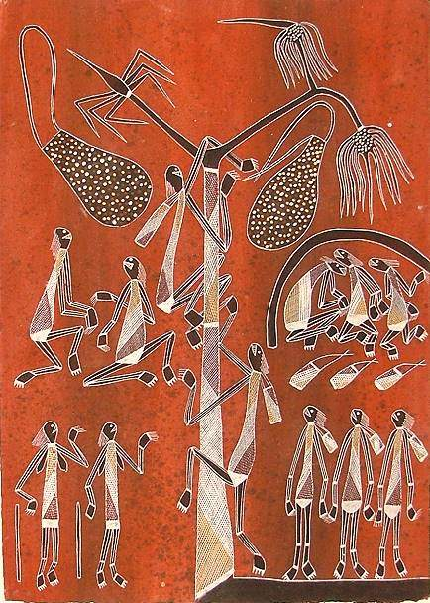
Art, Land and the Dreaming
Art is a central part of the life of Australian Aborigines and takes many forms.
Traditionally it was made for purely cultural reasons.
Uluru is a landscape of profound spiritual significance for Anangu Aborigines.
An non-copy art form: contrary to western culture aboriginal art must never be copied!

Slide 3
Brief History
Australian Aboriginal art is the oldest living art tradition in the world, with paintings in rock shelters dating back 20,000 years.
The art includes naturalistic paintings of human, plant and animal figures, as well as non-naturalistic, or "abstract" designs with concentric circles, "u" shapes, and lines.
Much of Aboriginal art relates to stories of the Dreamtime. This Dreamtime is the Creation Period in Aboriginal belief, when important Ancestral Beings formed the land and created the people, plants and animals. These Ancestral Beings, often depicted in the art, may take human, animal, plant or combined forms, and taught the people their laws and ceremonies.

Slide 4
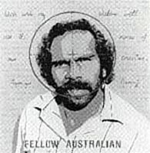
Aboriginal people
They are indigenous Australians (I.e. the first inhabitants)
They tell stories in words and pictures about how the world began
They call this Dreamtime
Their stories are called Dreamings

Slide 5
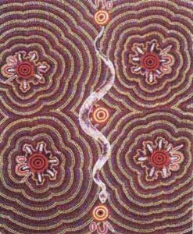
Aboriginal Paintings
This painting is called Witchetty Grub Dreaming by Mary Dixon Nungurrayi.
Click on the picture to take a closer look

Slide 6
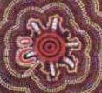
A witchetty grub is a kind of caterpillar that Aboriginal people traditionally eat.
The detail shows witchetty grubs around a camp fire.

Slide 7
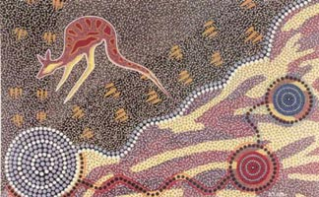
This painting is Journey of the Koori by Ron Potter. What do you think a Koori is?
It’s a kangaroo

Slide 8
Aboriginal paintings use earth colours
Why?
These are the colours of the desert. Aboriginal artists made their paints from natural materials.

Slide 9
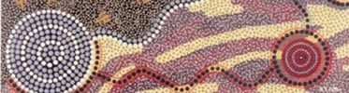
Aboriginal paintings are also often made up of dots
Why?
What did aboriginal artists paint with in the desert?
They used their fingers or sticks.

Slide 10
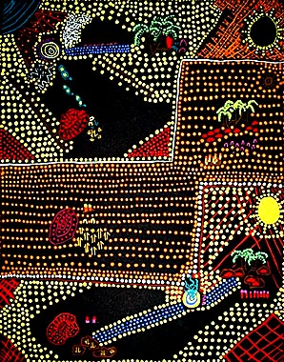
For Today
Aims
  Understand symbolism behind aboriginal art.
Objectives
  Complete 8 self produced aboriginal symbols from the list of words below to help tell a story about yourself:
    Birth
    Celebration
    Favourite hobby
    Pet
    Family
    Home
    Friends
    London

Slide 11
